Slide 1

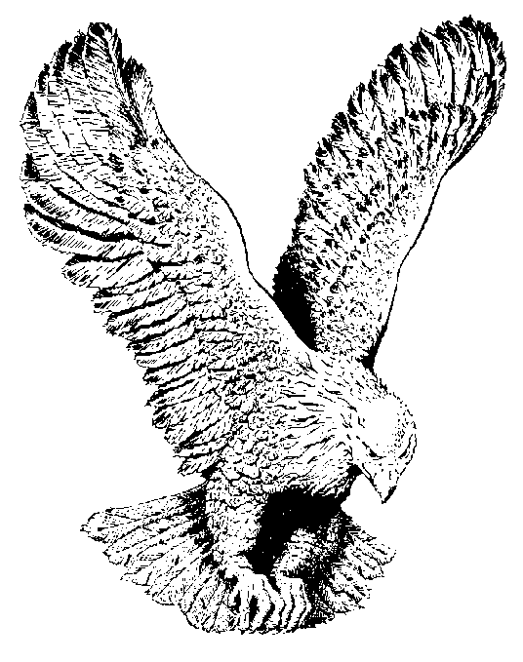
555 NO TURNING BACK
I have decided to follow Jesus,
I have decided to follow Jesus,
I have decided to follow Jesus,
No turning back, no turning back.

Slide 2
The cross before me the world behind me,
The cross before me the world behind me,
The cross before me the world behind me,
No turning back, no turning back.

Slide 3
Take this whole world but give me Jesus,
Take this whole world but give me Jesus,
Take this whole world but give me Jesus,
I won’t turn back, I won’t turn back.

Slide 4
I have started for the kingdom,
I have started for the kingdom,
I have started for the kingdom,
I won’t turn back, I won’t turn back.

Slide 5
Though none go with me, still will I follow,
Though none go with me, still will I follow,
Though none go with me, still will I follow,
No turning back, no turning back.

